Slide 1
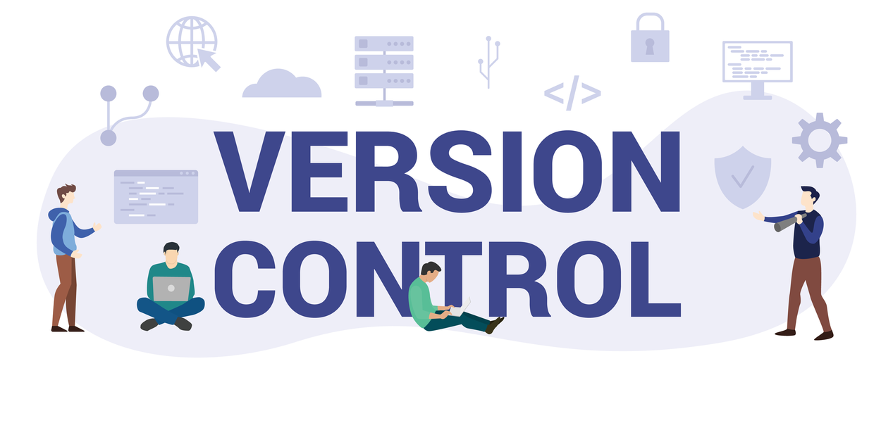
Version Control Systems
Farah Younas

Slide 2
Version Control Systems
A Version Control System (VCS) is a tool used in software development and collaborative projects to track and manage changes to source code.
  Tracks and records changes to the codebase, maintaining a structured project history.
  Allows multiple developers to collaborate on the same project without overwriting each other's work.
  Developers access and update a central repository, where project files are stored.
  Enables teams to share updates and revert to earlier versions of the project when needed.

Slide 3
Components of Version Control Systems
Version Control Systems work using a few core concepts that help teams manage code changes and collaborate efficiently.
  Repository: A central location that stores all project files along with their complete change history and metadata like author and commit message.
  Revision: A specific saved version of a file or project, identified using a unique ID such as a hash or number.
  Branch: A separate copy of the codebase used to develop features or fix bugs without affecting the main code.
  Merging: The process of combining changes from one branch into another, which may sometimes require resolving conflicts.
  Commit: A snapshot of changes made to the codebase at a specific time, used to track and manage project history.

Slide 4
Types of Version Control Systems
There are three main types of Version Control Systems:
Local Version Control Systems (Local VCS)
Centralized Version Control Systems
Distributed Version Control Systems

Slide 5
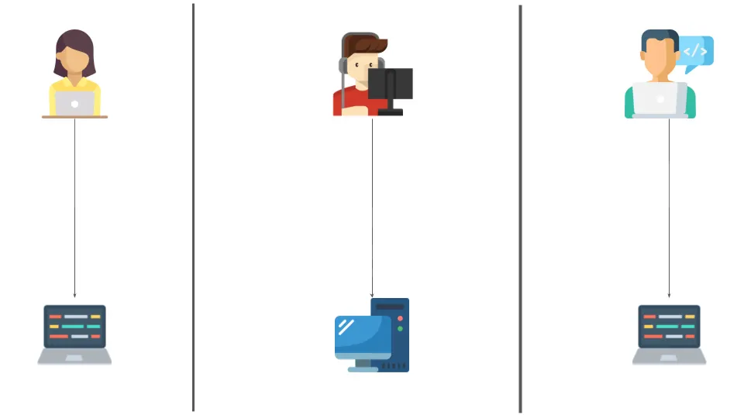
Local Version Control Systems (Local VCS)
A Local Version Control System (LVCS) stores all project versions on a single computer and is mainly used by one user without remote collaboration.
Characteristics:
  No internet or server dependency.
  Useful for individual projects.
  Limited to single-user environments.

Slide 6
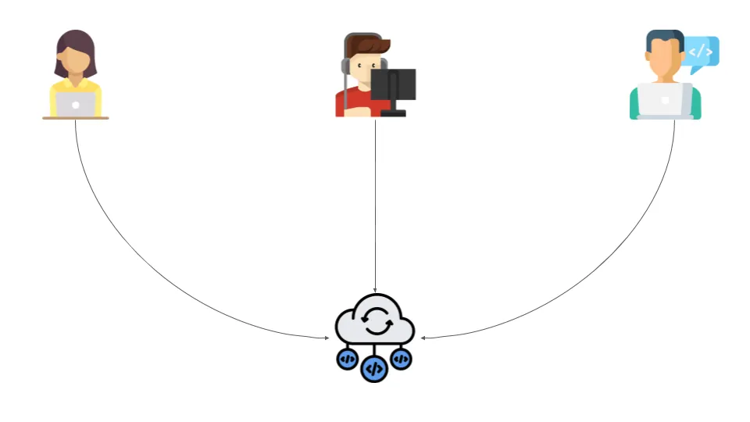
Centralized Version Control Systems
In a Centralized Version Control System, all the files and their version history are stored in a single central server.
Developers connect to this server to access or modify files.
  Update/Checkout: A developer retrieves the latest version of the files from the central server.
  Make Changes: The developer works on the files.
  Commit: The developer saves (commits) the changes directly back to the central server, making them immediately available to everyone else.

Slide 7
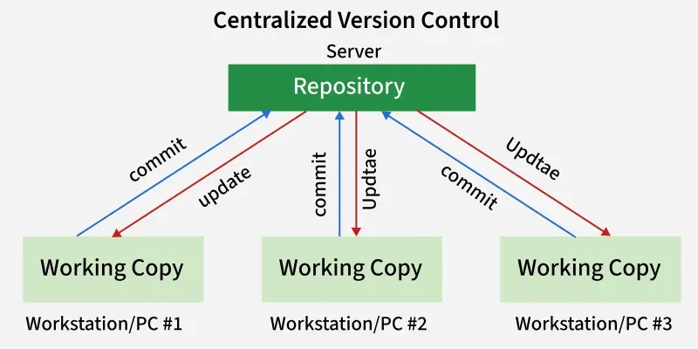
Centralized Version Control

Slide 8
Centralized Version Control Systems
Pros | Cons
Enables collaboration among multiple developers through a central repository. | Has a single point of failure because everything depends on the central repository.
Provides visibility into project activities and changes. | If the server goes down, developers cannot collaborate or commit changes.
Allows fine-grained access control for administrators.

Slide 9
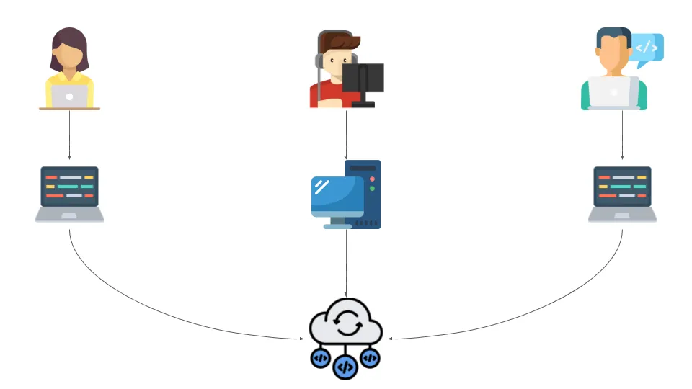
Distributed Version Control Systems
A Distributed Version Control System allows each developer to have a local repository along with a working copy of the project.
Changes made in the local repository are not automatically visible to others.
  Commit: Saves changes to the local repository, visible only to the developer.
  Push: Uploads committed changes to the central/shared repository so others can access them.
  Pull: Downloads changes from the central repository to the local repository.

Slide 10
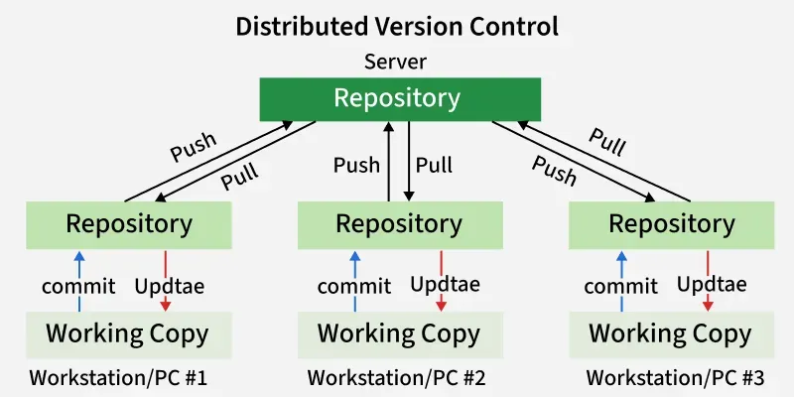
Distributed Version Control

Slide 11





Popular Version Control Systems
Each of these version control systems serves different needs, and the choice depends on the project size, team collaboration style and workflow preferences.
Git
Mercurial
Subversion
Bazaar
CVS

Slide 12
Git
Git is a widely used Distributed Version Control System developed by Linus Torvalds in 2005 for managing the Linux kernel.
It supports decentralized workflows and is used by platforms like GitHub, GitLab, and Bitbucket.
Lightweight, fast, and efficient.
Simple and non-destructive branching and merging.
Provides powerful commands like git clone, git pull, and git push.

Slide 13
Subversion (SVN)
Subversion is a popular centralized version control system.
While it is not as commonly used in open-source projects today, SVN is still widely used by many organizations and enterprises for its simplicity and centralized structure.
  Single central repository.
  Supports branching and tagging but it is less flexible compared to Git.
  Versioning of files and directories.

Slide 14
Mercurial
Mercurial is a distributed version control system similar to Git but with a simpler interface. It is well-suited for both small and large projects and is used in various open-source and enterprise projects.
  Simple, fast and scalable.
  Supports branching and merging.
  Includes tools for managing project history and changes.

Slide 15
CVS (Concurrent Versions System)
CVS is an early centralized version control system widely used in the late 1990s and early 2000s. It influenced modern VCS tools and laid the foundation for systems like Subversion.
  Centralized repository architecture.
  Tracks changes to individual files over time.
  Allows multiple developers to work on the same codebase.
  Basic support for branching and tagging, though more limited than modern alternatives.

Slide 16
Bazaar
Bazaar is a distributed version control system developed by Canonical (creators of Ubuntu).
It supports both centralized and distributed workflows and was used in projects like Ubuntu and Launchpad.
  Supports centralized and distributed version control models.
  Beginner-friendly and easy to learn.
  Uses human-readable commands like bzr commit and bzr push.
  Cross-platform support (Linux, Windows, macOS).

Slide 17
Git

Slide 18
Git
Git is a distributed version control system that helps track and manage changes in code over time.
It allows multiple developers to work on the same project, view previous versions, and restore changes when needed.

Slide 19
Features of Git
Version Control System: Git keeps track of every change you make to your project files. You can go back to previous versions is any requirement arises.
Repositories: A Git repository (or repo) is like a project's central hub where everything related to your work is stored and managed. There are two main types:
  Local Repository: This is a copy of the repository which is stored in your computer. You can work on your project and make changes here.
  Remote Repository: This is stored on a server, like GitHub, where you and others can share and work on a project.

Slide 20
Features of Git
Commits: Every time you make changes and save them in Git, these are called commits. The repository keeps track of all the commits you have made.
Branches: A repository allows you to create Branches and work on new features and fixes. For example, you can have a "main" branch for stable code and a "feature" branch for new features you're developing.
Merging: Once you are done with the branches you have made, you can merge those branches into main branch. This adds the changes you have made in the rest of the project.
Cloning: Cloning is a process of making a complete copy of Git repository. It's like copying the entire project from central location ( like website) to your own computer.

Slide 21
Reasons to Choose Git
Distributed System: Every developer has a complete local copy of the project, allowing for offline work and increased resilience.
Performance: Git is fast and efficient, handling large projects with ease.
Branching and Merging: Git's lightweight branching and easy merging facilitate parallel development and feature isolation.
Collaboration: Tools like GitHub enhance team collaboration, code reviews, and project management.
Track Changes: Git tracks changes and maintains a history, making it easy to revert to previous versions.

Slide 22
Steps to Setup a Git
Refer to Manual

